Slide 1
Design, Manufacturing and Testing of a Hybrid Rocket Engine
UNH Students for the Exploration and Development of Space (SEDS)

Slide 2
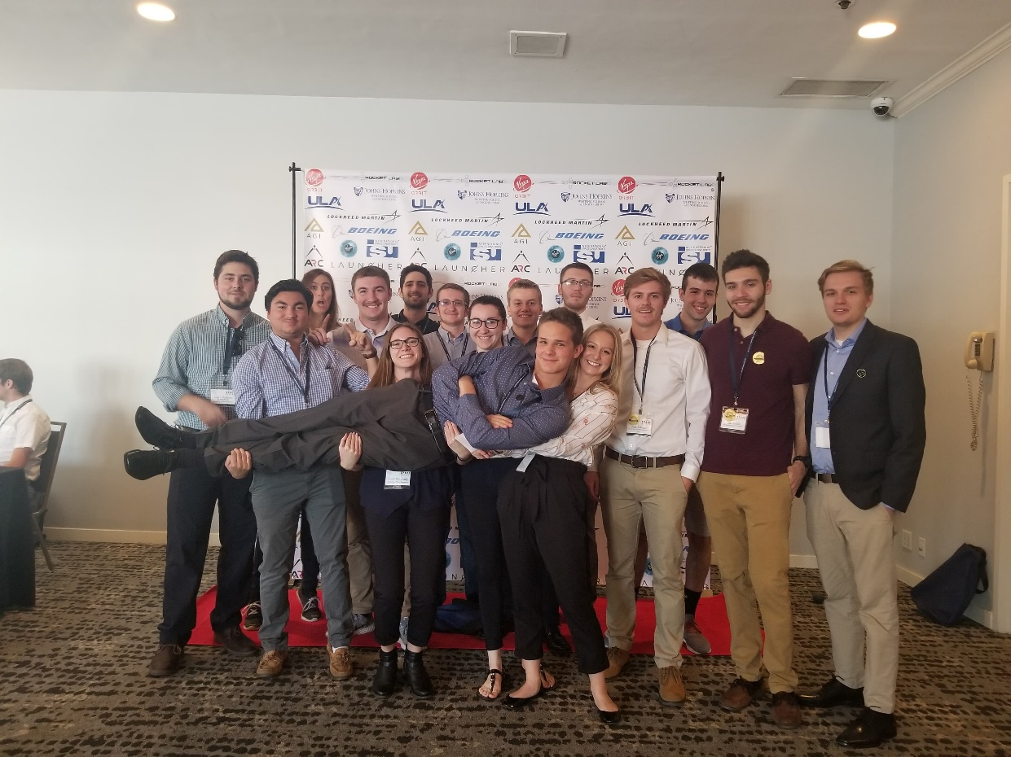
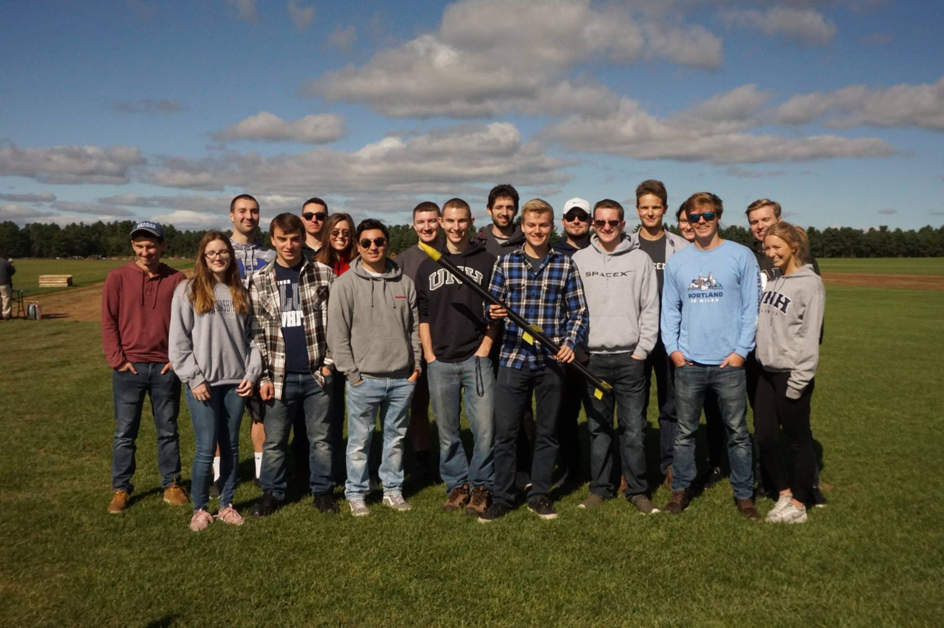
What is UNH SEDS?
A single chapter within a nationwide organization
Aerospace engineering organization within CEPS
Founded April 2017
Comprised of 25 passionate students of 6 different majors

Slide 3
My Vision
Year 1
2017-2018
Amateur Rocket Building Techniques
Year 2
2018-2019
Throttle Controlled Rocket Engine
Year 3
2019-2020
Competition Rocket for Spaceport

Slide 4
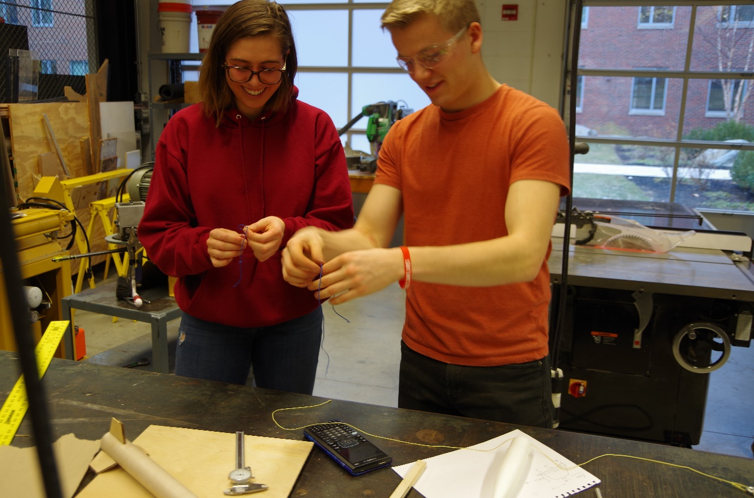
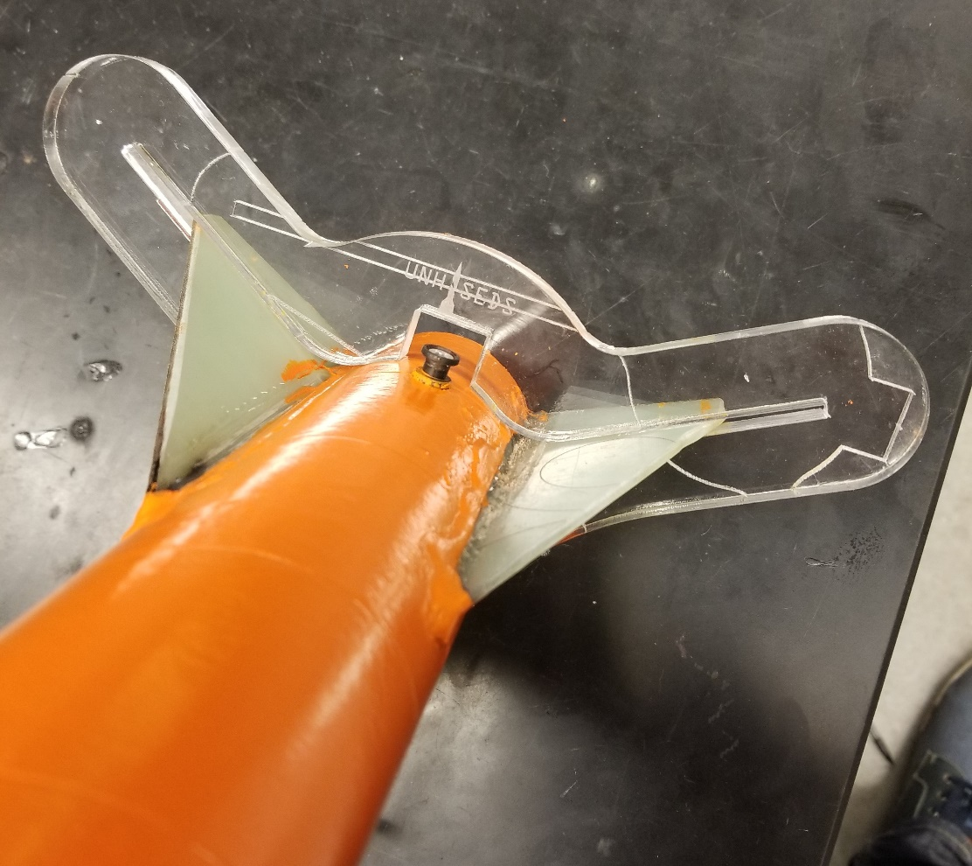
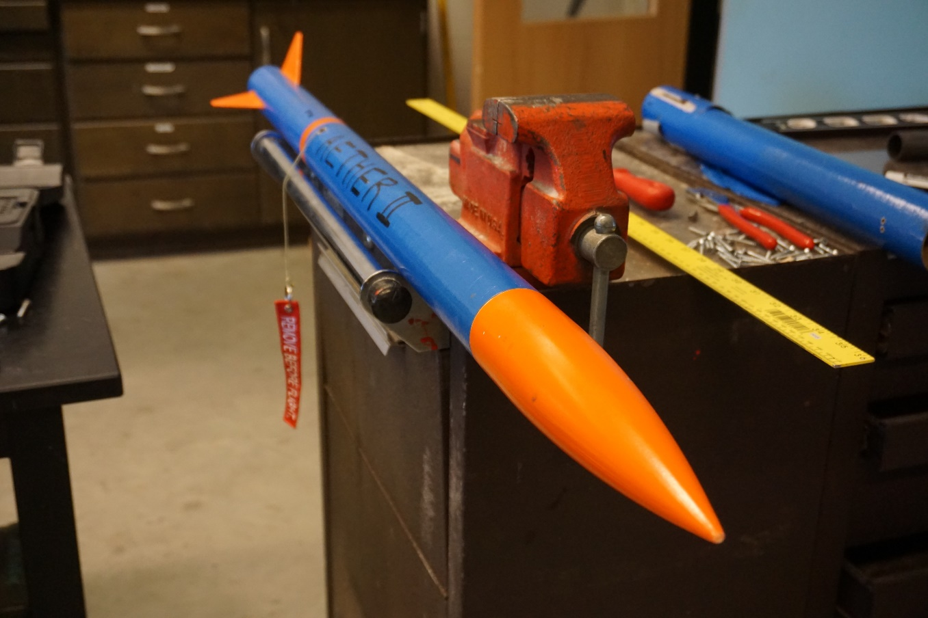
Year 1 Amateur Rocket Building Techniques Building Composite Rocket
No prior experience with rockets whatsoever
Trial and error method
Single stage rockets
Did it land in a tree?
Multi-stage rockets
Staging components
Staging electronics
GPS
Did it land in a lake?

Slide 5
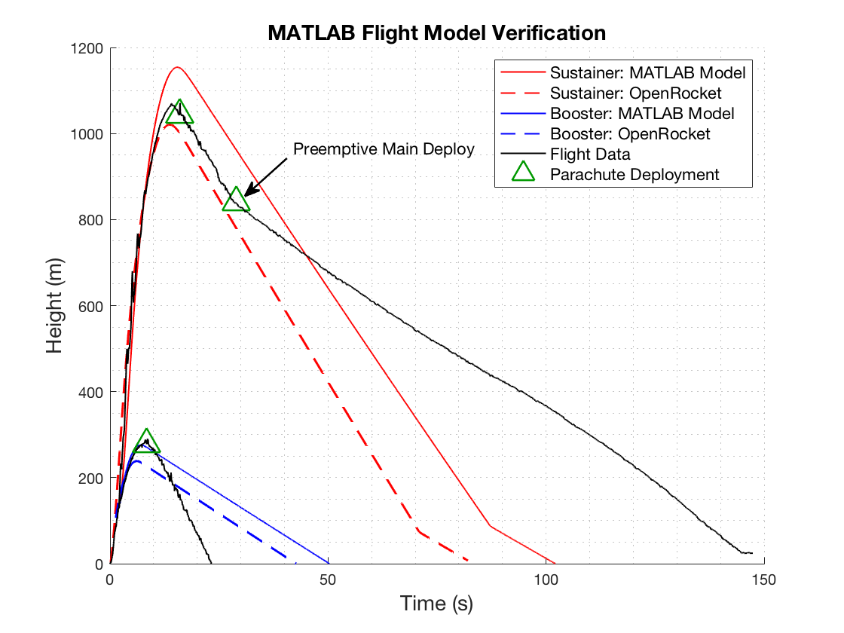
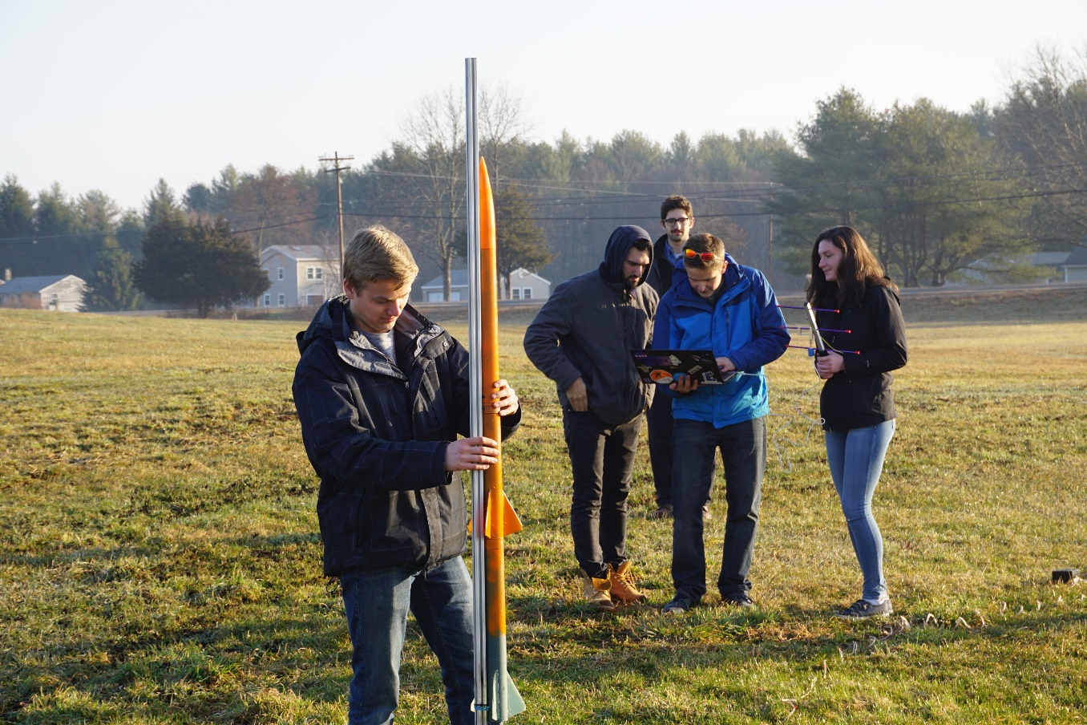
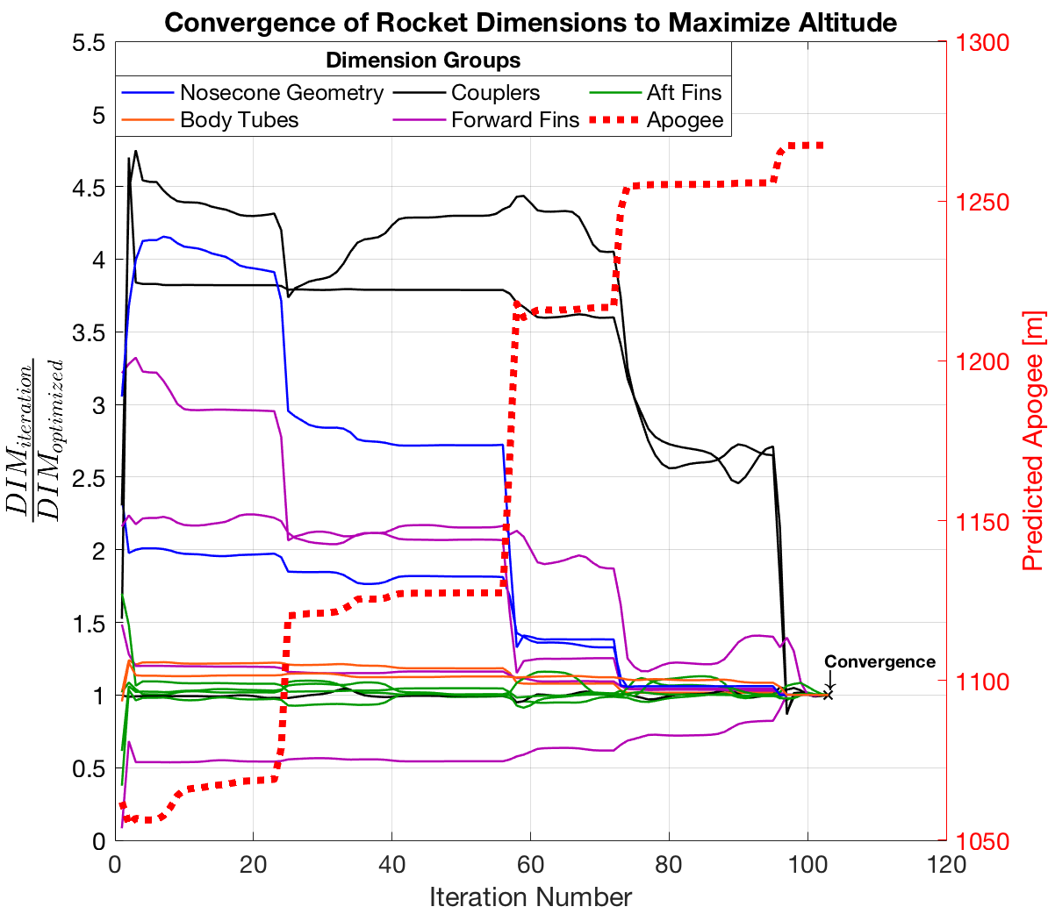
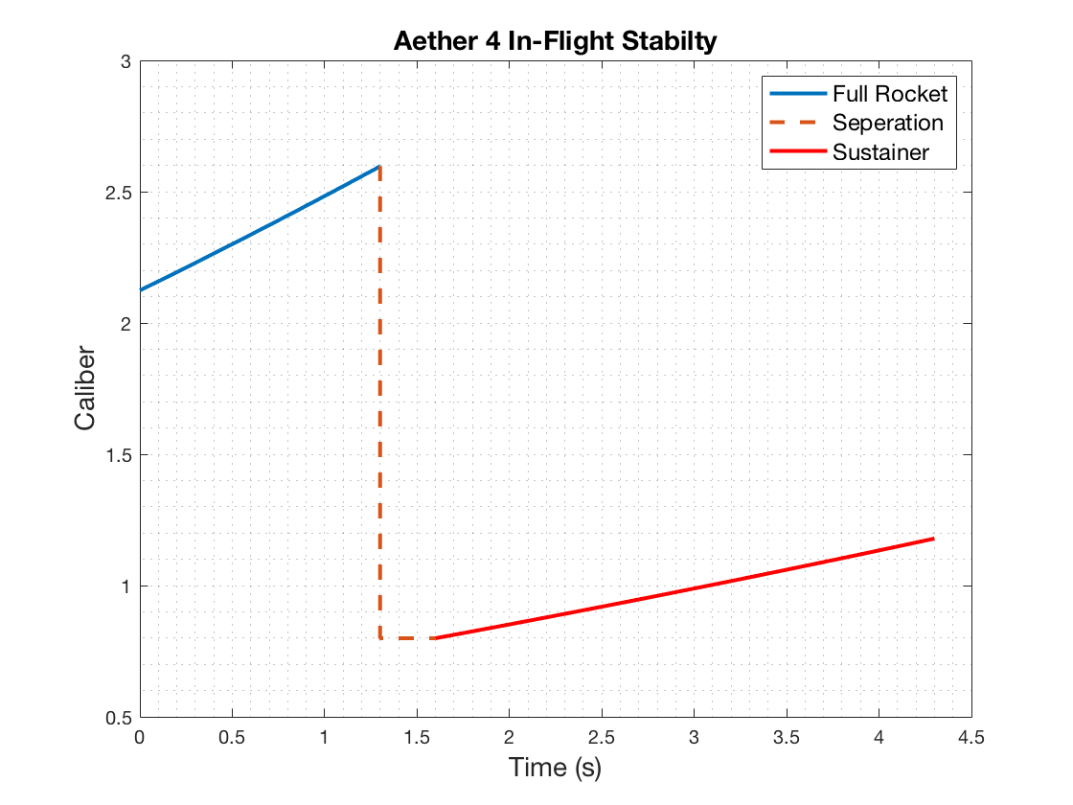
Year 1 Amateur Rocket Building Techniques Simulation and Testing

Slide 6
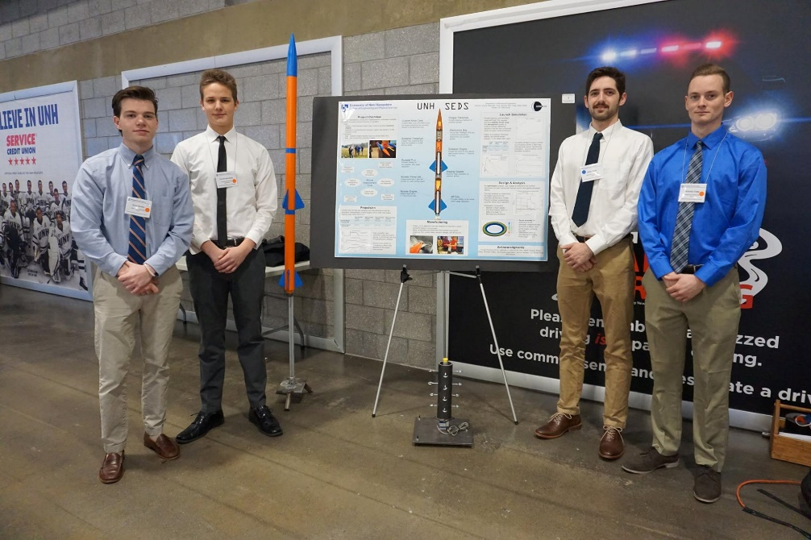
Year 1 Amateur Rocket Building Techniques Presentations and Awards
Presentations are a great way to consolidate your learning over a year
2nd Place at the URC – Engineering Competition Teams – April 2018
4th place overall in the University Student Rocketry Competition October 2018

Slide 7

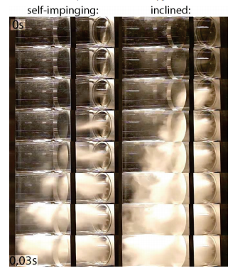
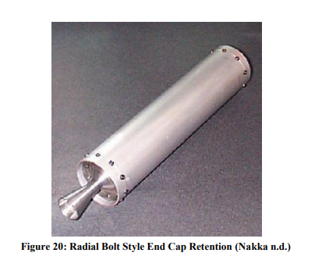
Year 2 Throttle Controlled Rocket Engine Research Literature
Rocketry is an experimental field
Research related literature on rocket engine design
Review other engineering reports on hybrid rocket engines
What went right?
What went wrong? Why?

Slide 8
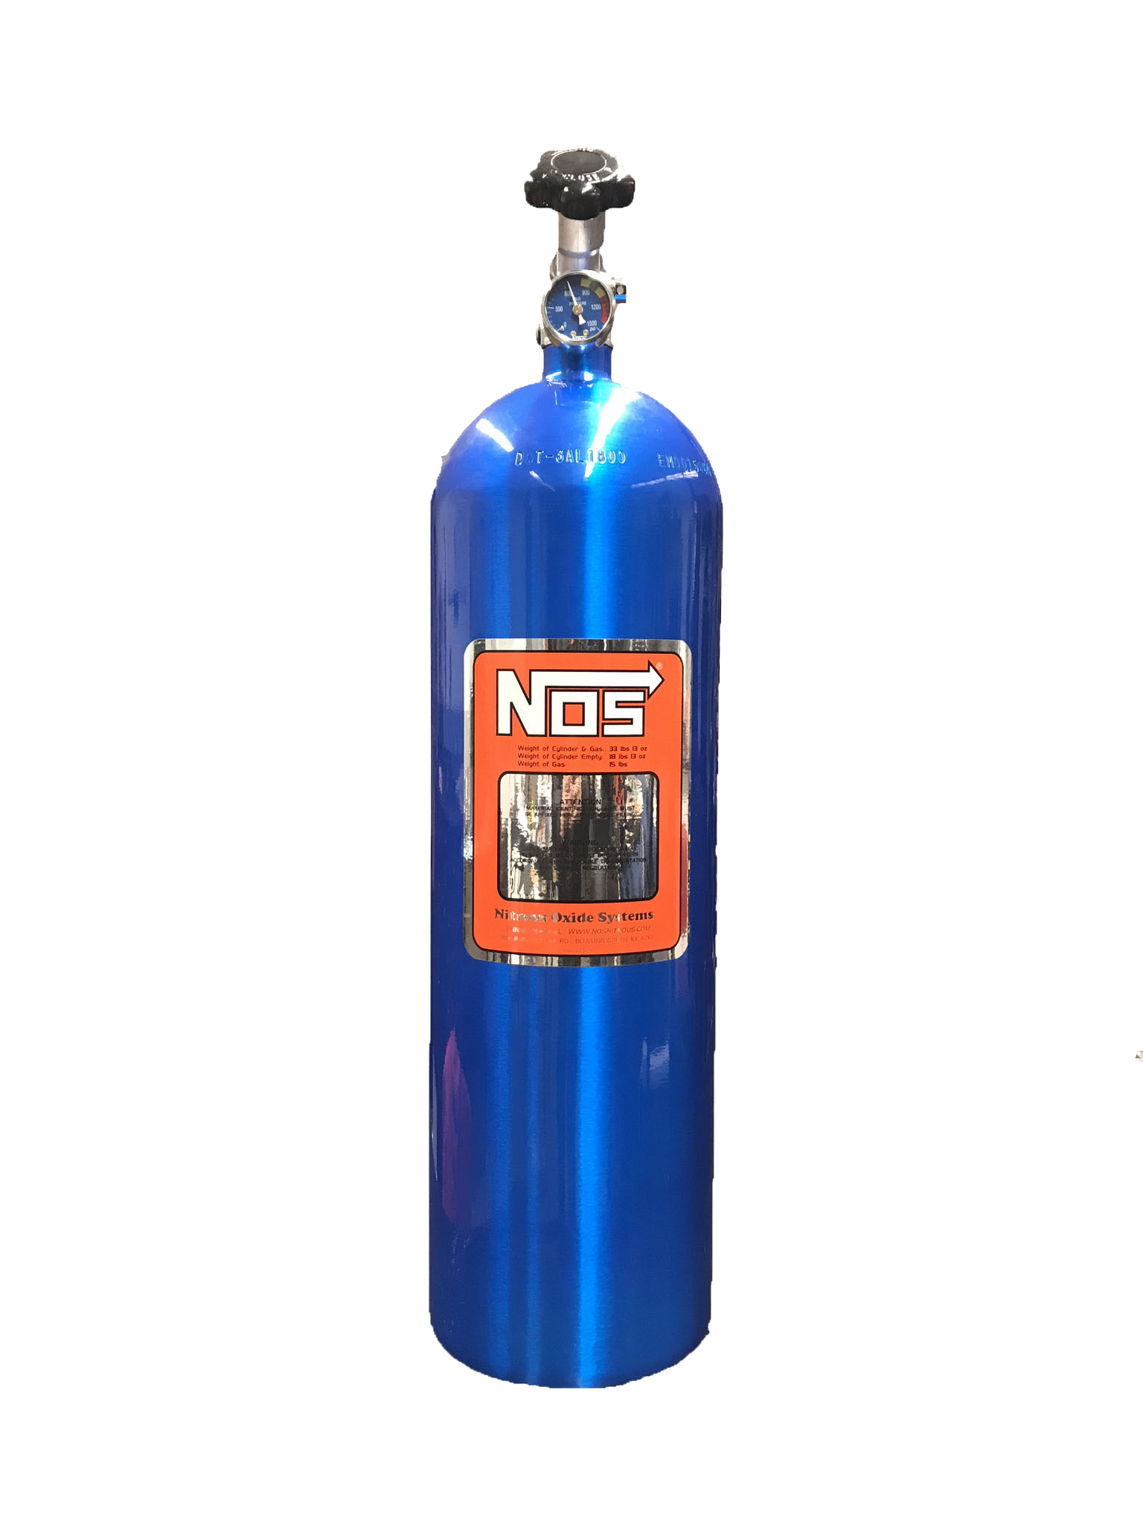
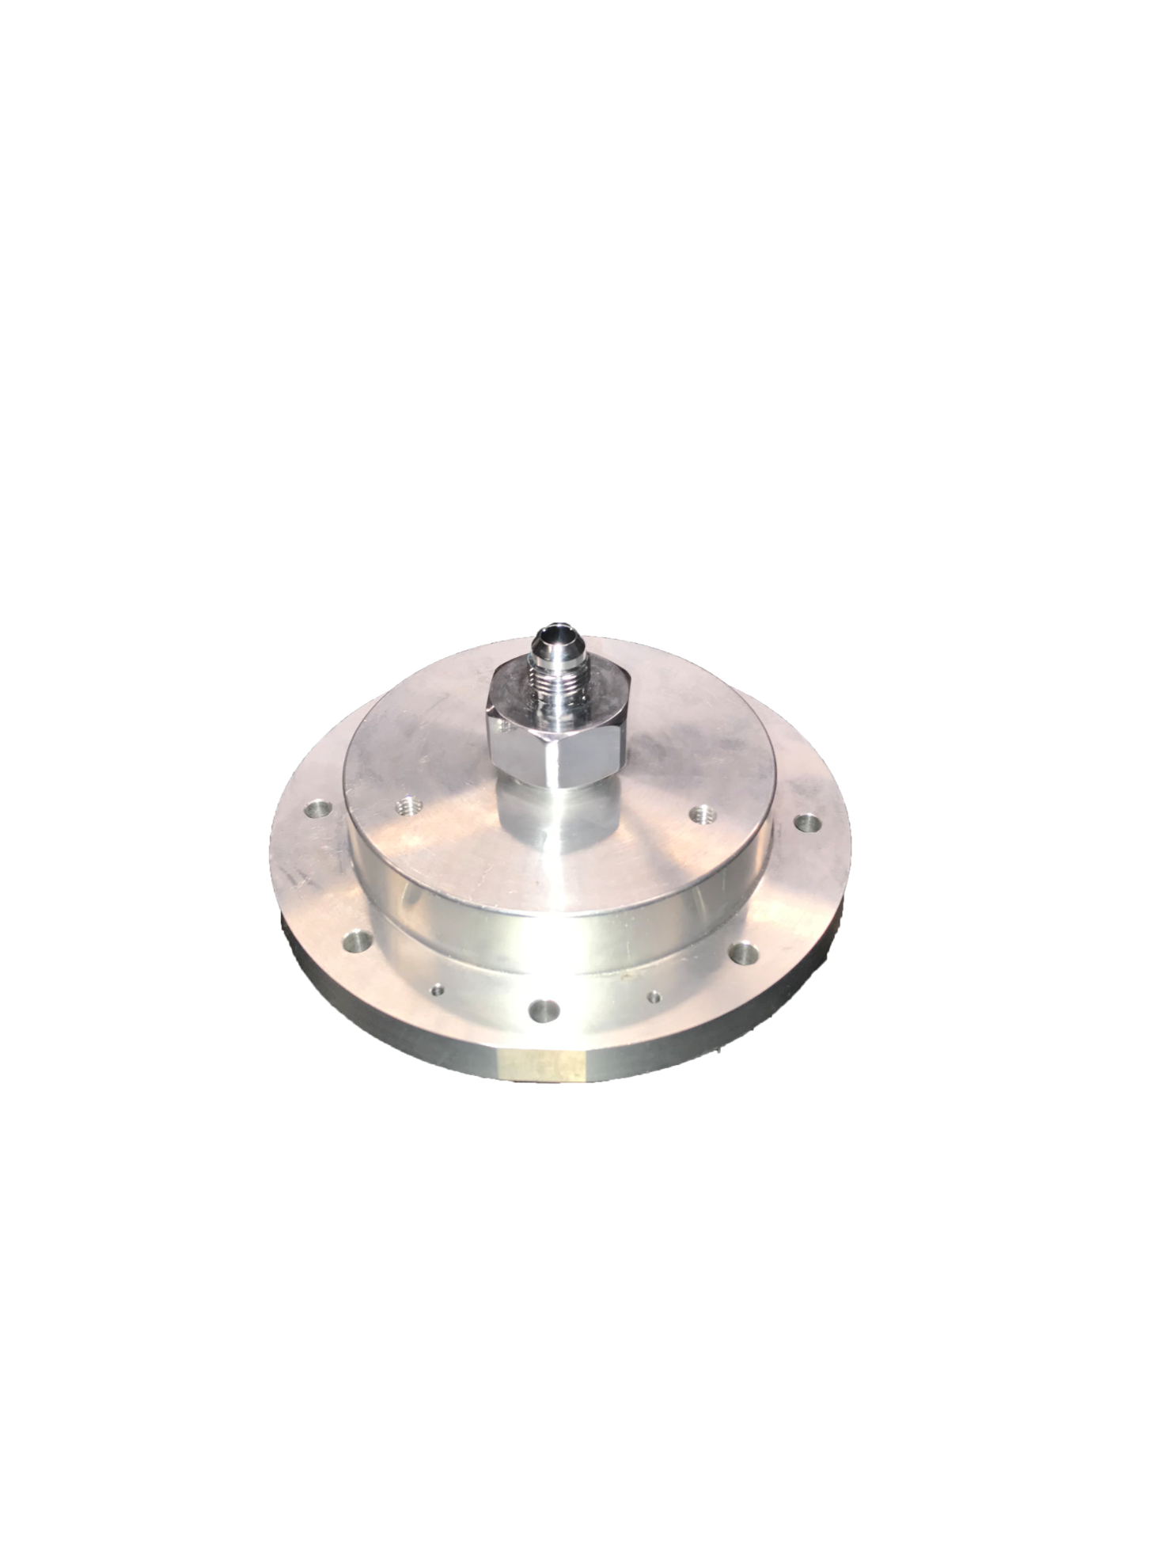
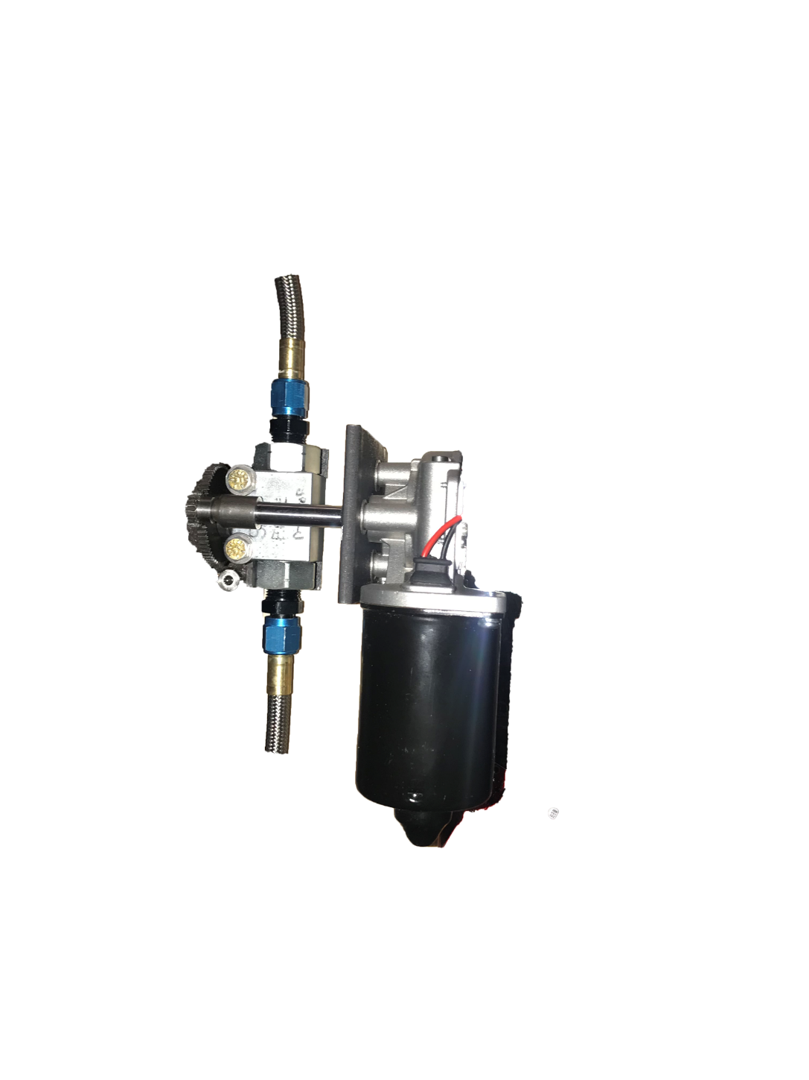
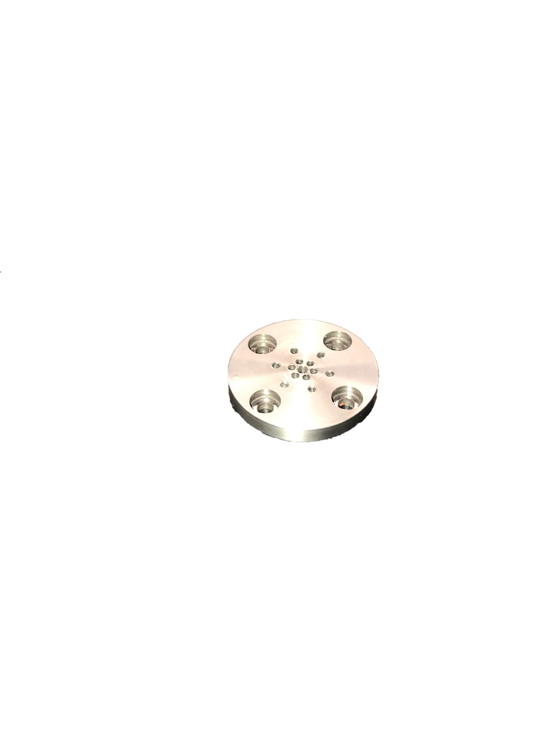
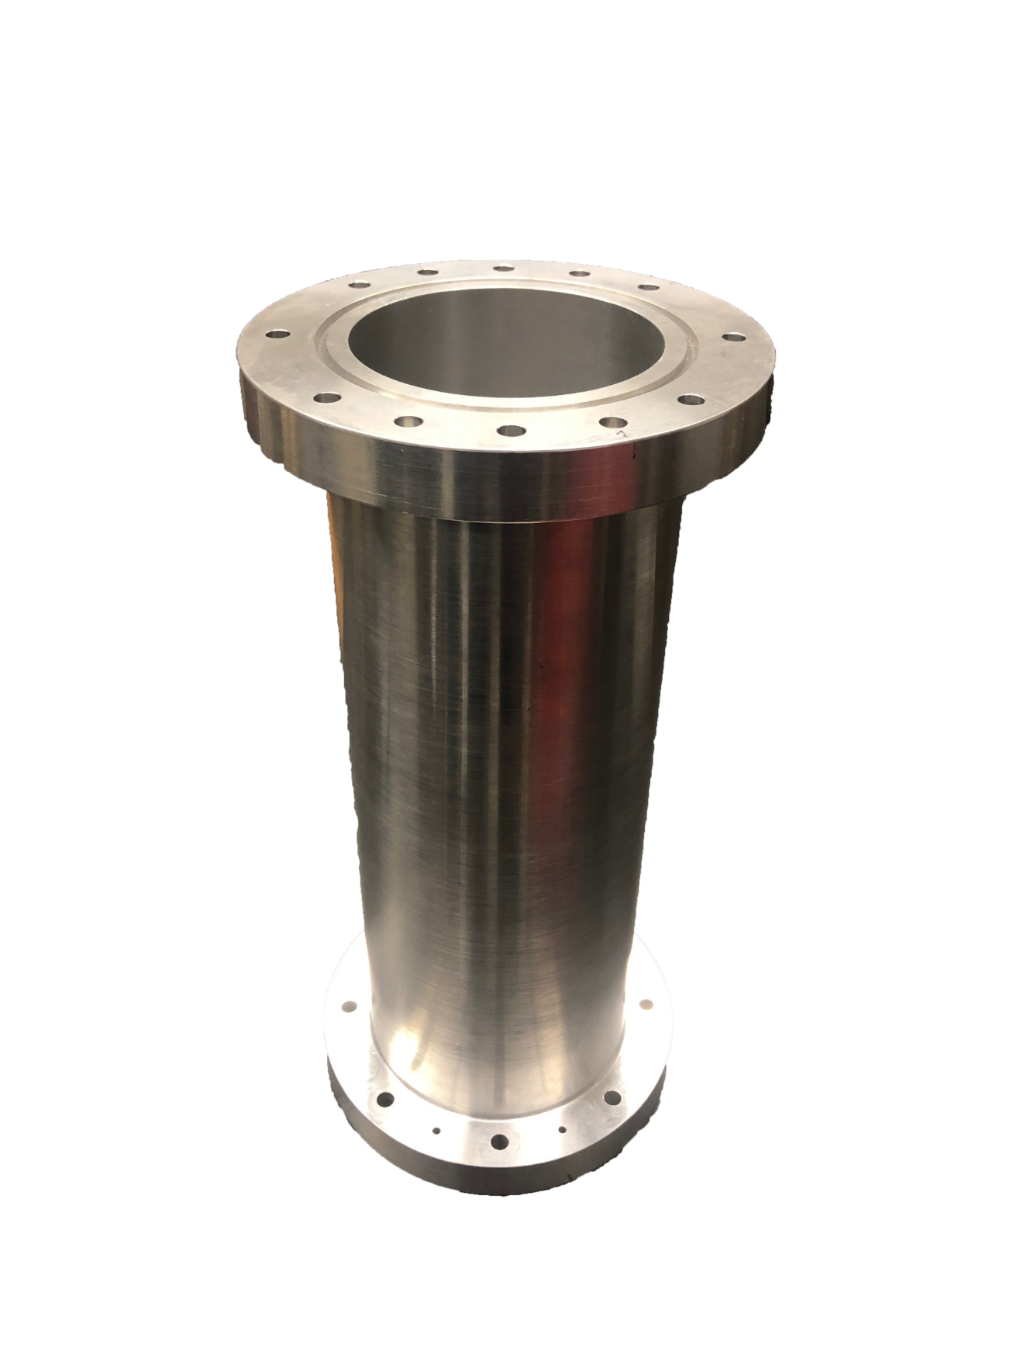
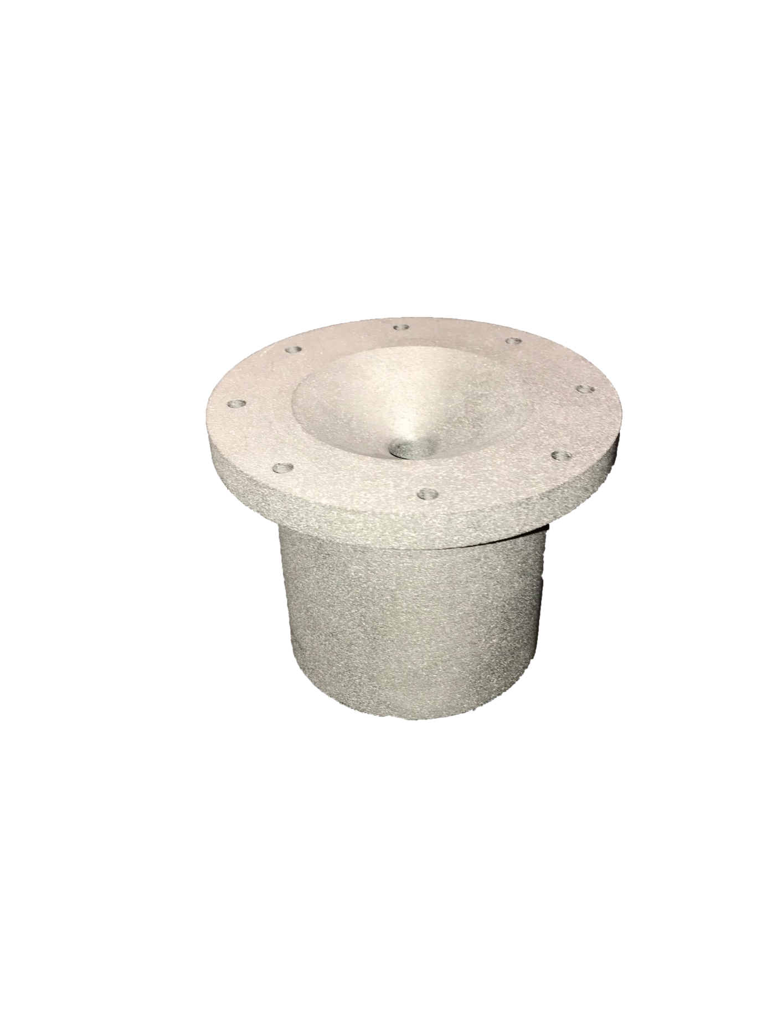
Year 2 Throttle Controlled Rocket Engine Concept
Oxidizer Tank
Injector Plate
Combustion Chamber
Flow Regulator
Impinging Plate
Nozzle

Slide 9
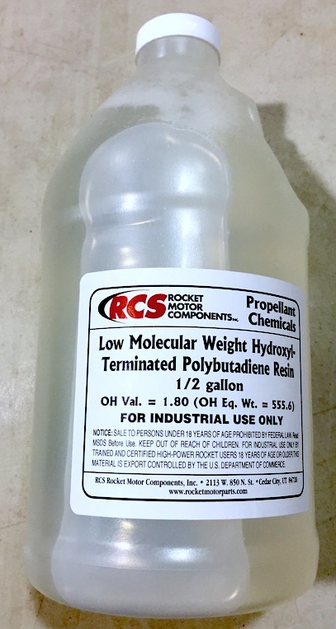
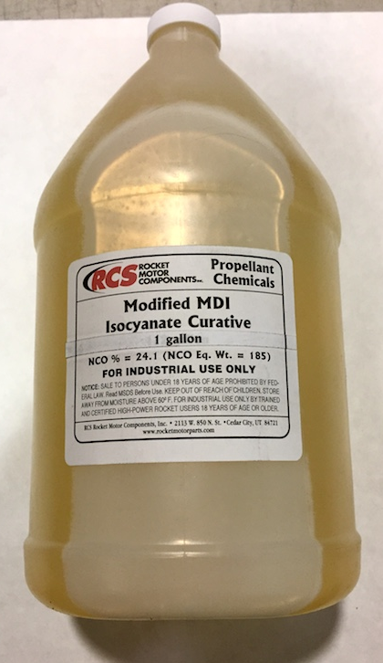
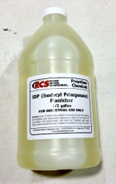
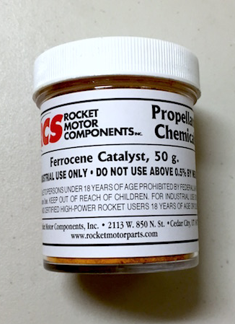
Year 2 Throttle Controlled Rocket Engine Reducer and Oxidizer
Nitrous Oxide
HTPB Ingredients
Location of Reducer Mold
Burn Rate Catalyst

Slide 10
Year 2 Throttle Controlled Rocket Engine Oxidizer Flow Control
Positioned upside down as it is in liquid phase within the tank
Flow regulator controlled by an Arduino and motor controller and implementing an electric motor and gear system

Slide 11
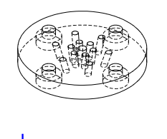
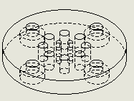
Year 2 Throttle Controlled Rocket Engine Injector Plate Design
Example impinging-inward plate
Top-side of the injector plate responsible for collecting the output of the flow regulator
Shower-Head Design

Slide 12
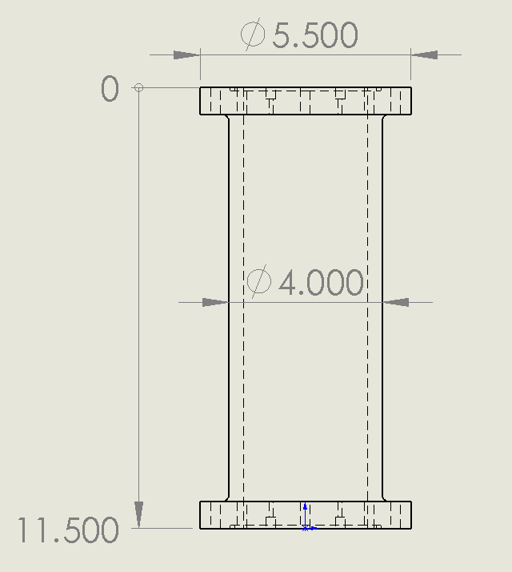
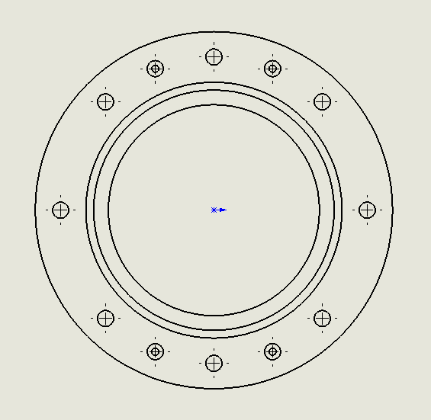
Year 2 Throttle Controlled Rocket Engine Combustion Chamber Design
5.5 Inch flange with bolt holes to allow easy connection to the injector plate and nozzle
O-Ring to constrain the combustion gases inside the chamber
Alignment pins for precise assembly

Slide 13
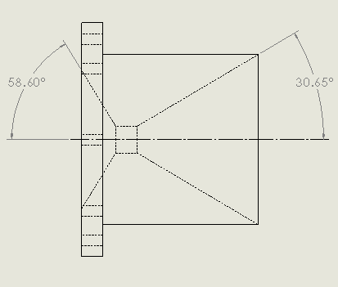
Year 2 Throttle Controlled Rocket Engine Nozzle Design
Thermal Energy
to
Kinetic Energy
Graphite utilized for its known temperature and corrosion resistance as well as price

Slide 14
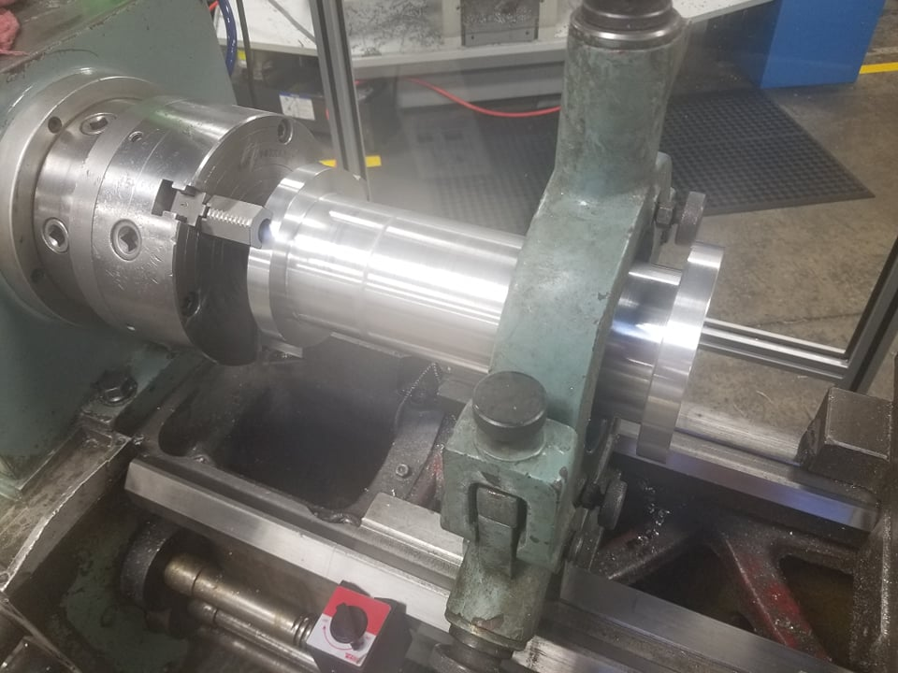
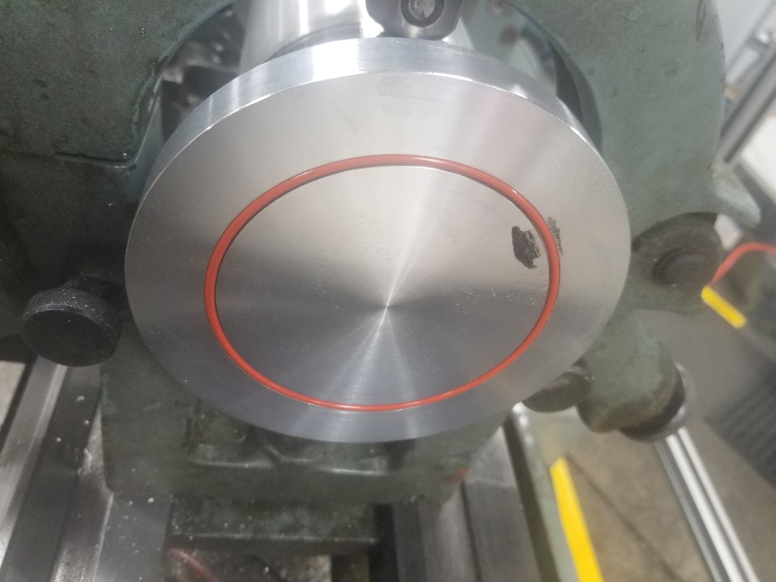
Year 2 Throttle Controlled Rocket Engine Component Manufacturing

Slide 15
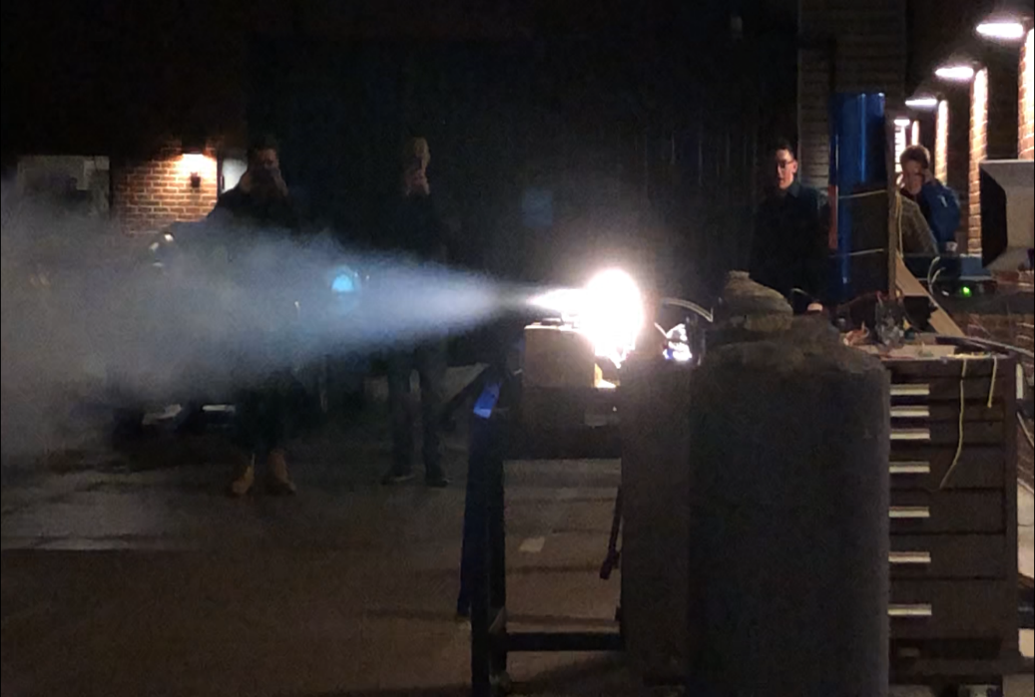
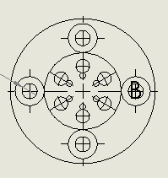
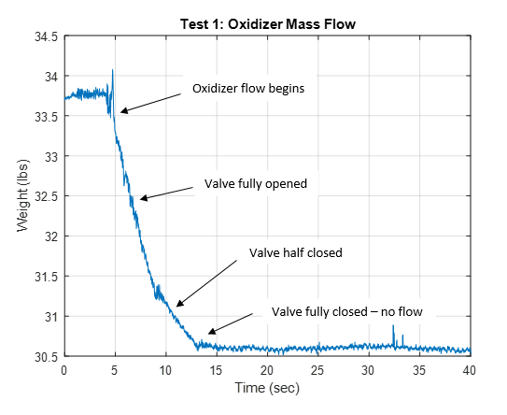
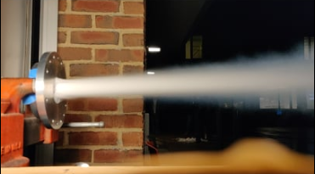
Year 2 Throttle Controlled Rocket Engine Cold Test - Injector

Slide 16
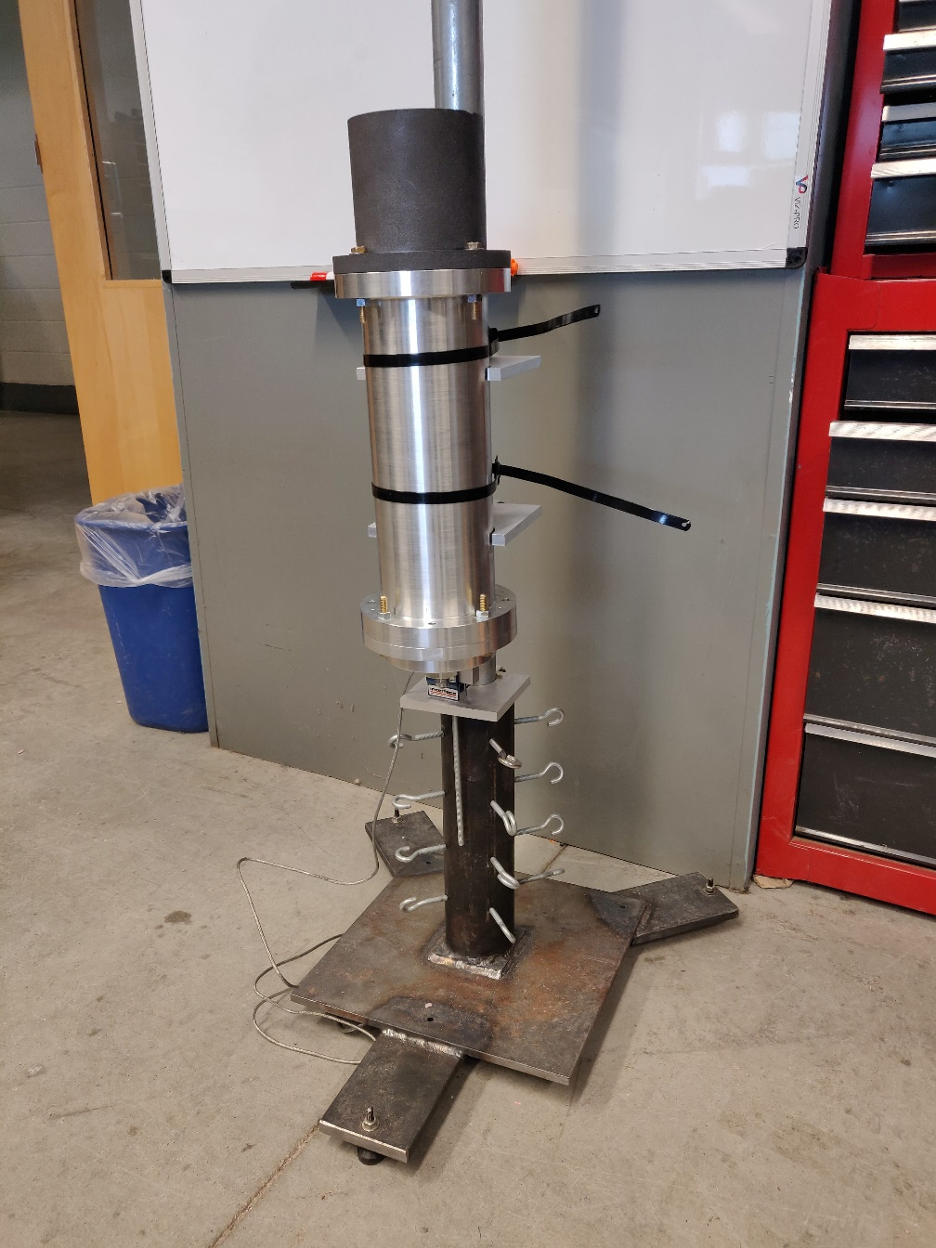
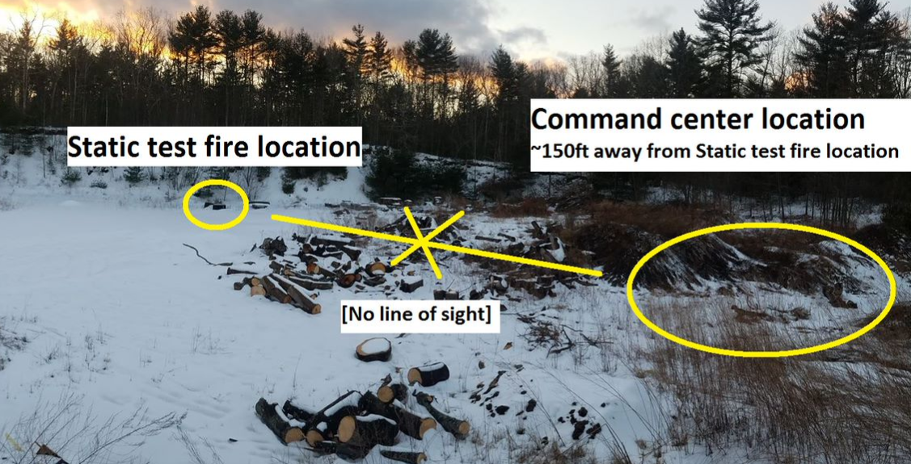
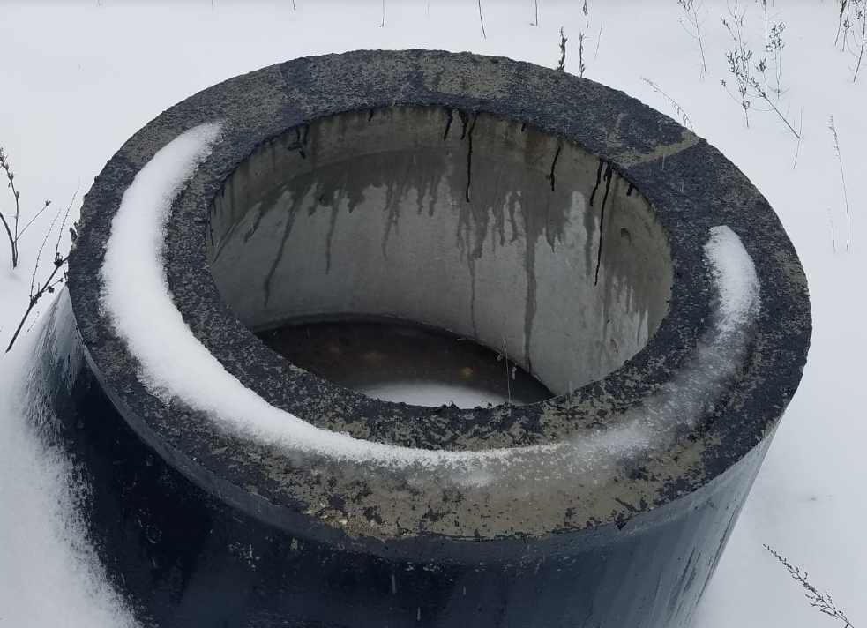
Year 2 Throttle Controlled Rocket Engine Safety - Hot Fire Test
Location for hot test fire
Sandpit on Garrity Road
Durham and Lee PD and FD will be present for security
4 foot deep concrete cylinder

Slide 17
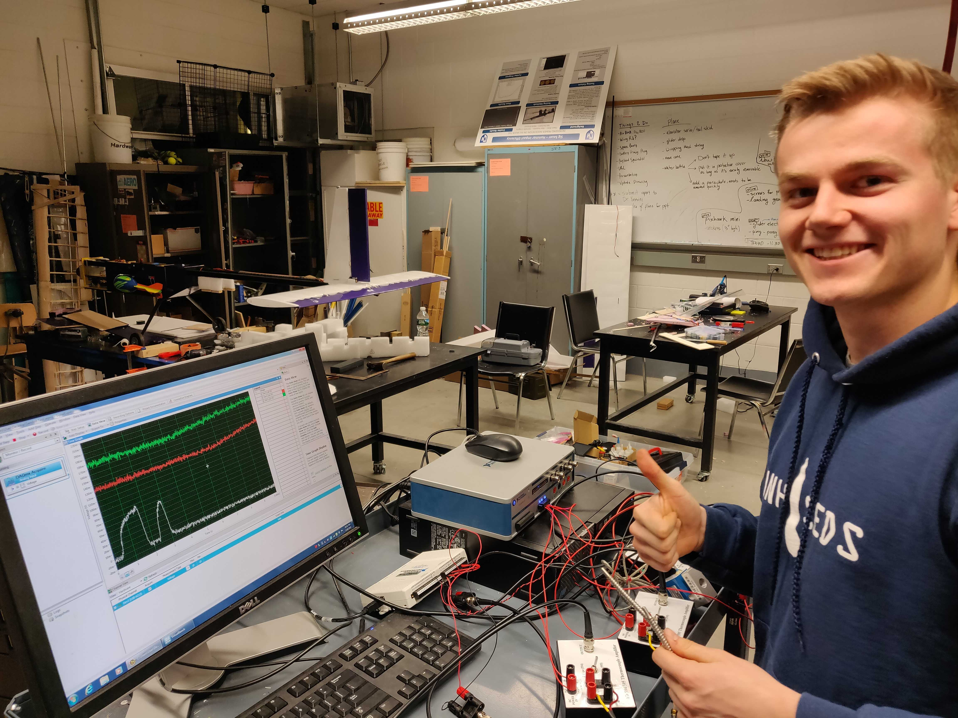
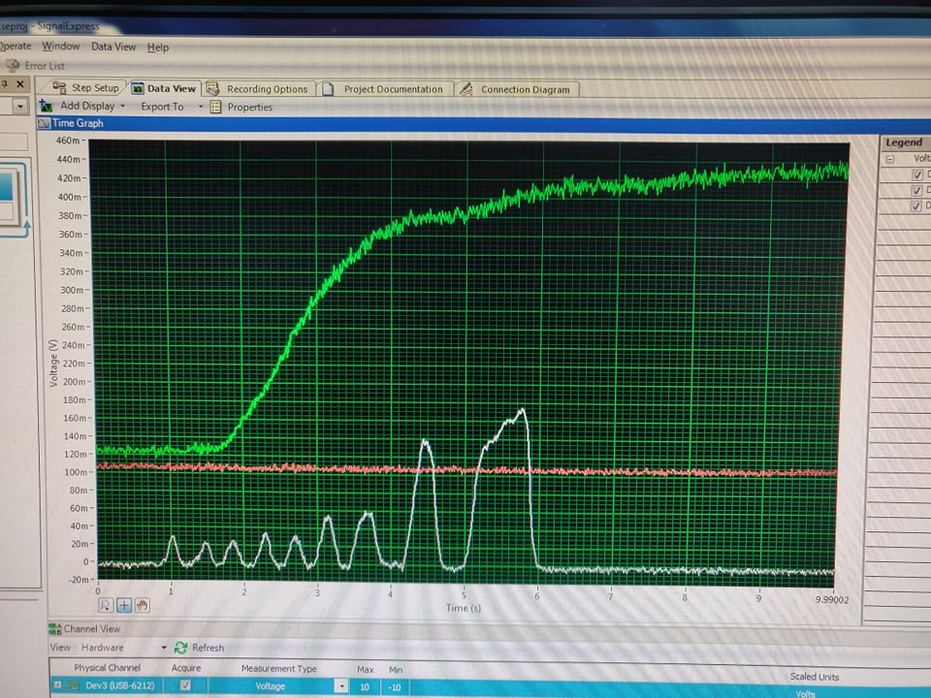
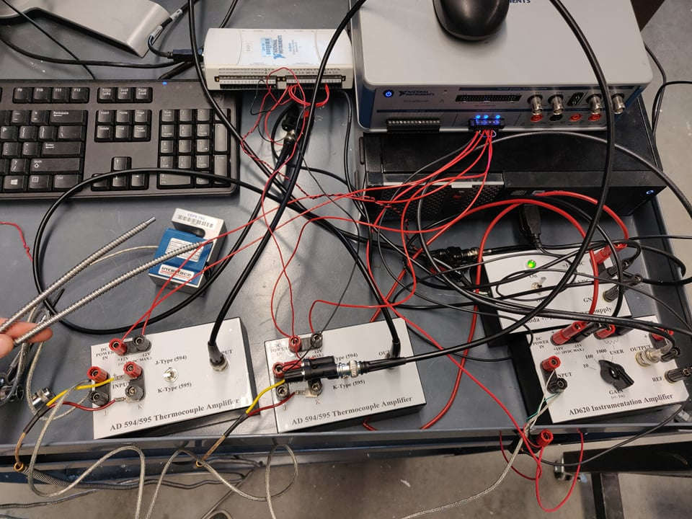
Year 2 Throttle Controlled Rocket Engine Data Collection - Hot Fire Test
Our amazing Vice President, Thomas Collins, excited for the test tomorrow!
Load Cell and Thermocouple data collection equipment to gather necessary information for future optimization
(the wires will be cleaned up… hopefully)

Slide 18
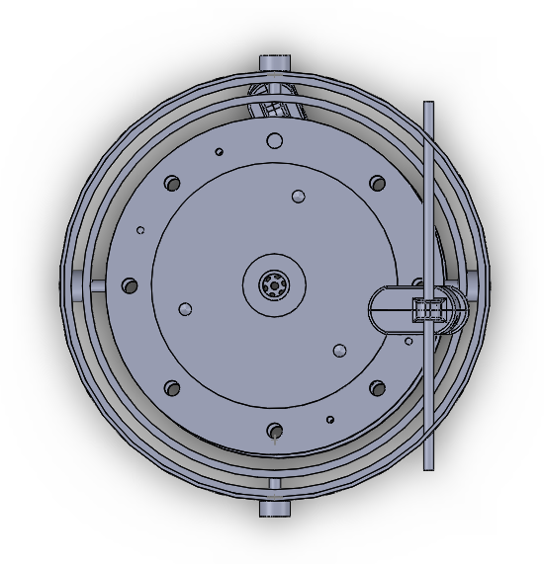
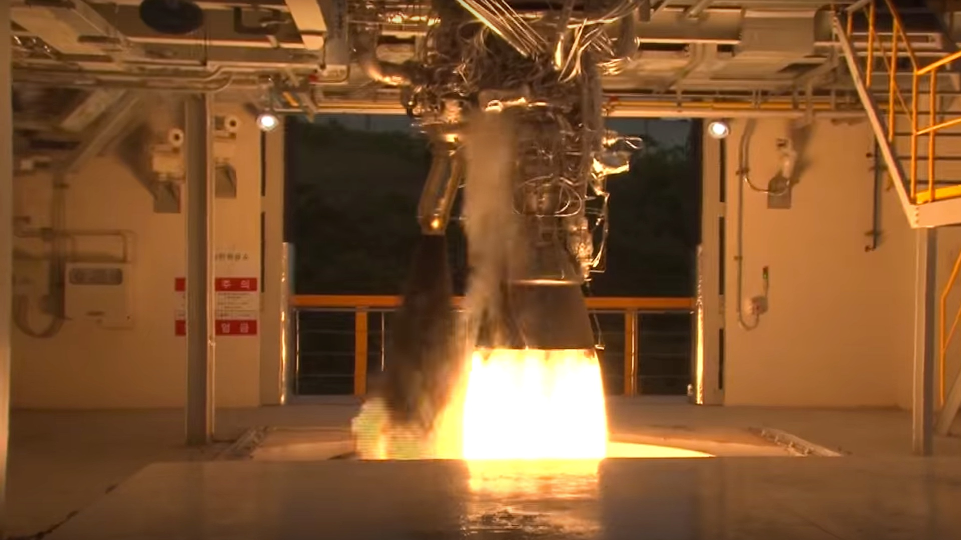
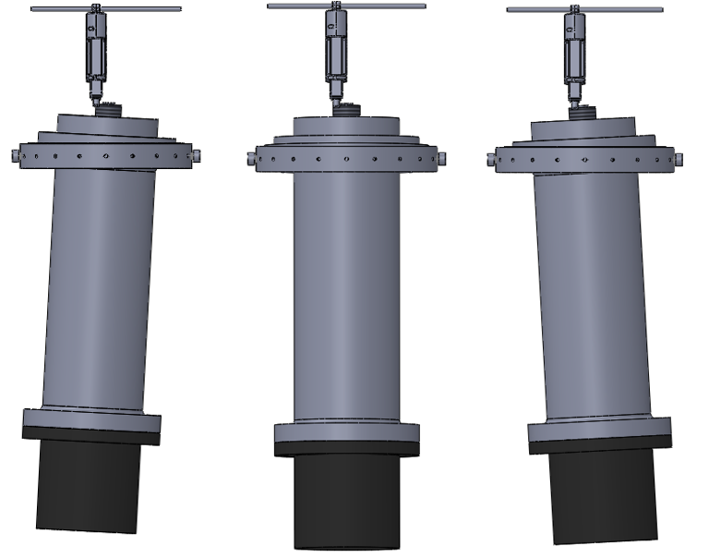
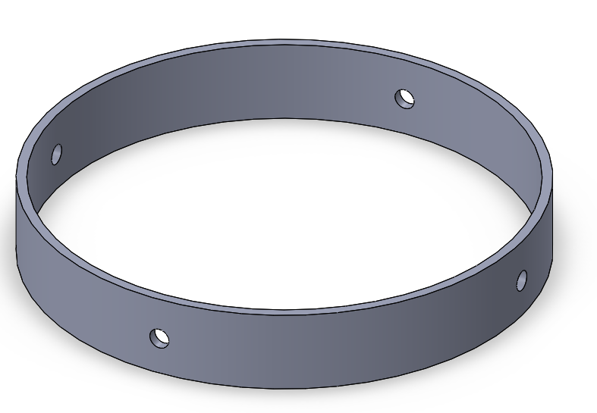
Year 2 Throttle Controlled Rocket Engine Moving Forward
Further Engine Optimization
Full Gimbal Assembly
Gimbal Ring supporting 2 dimension engine movement

Slide 19

Year 3 Competition Rocket for Spaceport Goals
Design, manufacture and fly a 8 inch diameter hybrid-propelled rocket to 10,000 feet
Incorporate the year 2 hybrid rocket engine
Further optimization of the hybrid rocket engine
Maximize thrust output
Implement a gimbal system into the rocket to control the thrust vector of the engine during flight for stability and control

Slide 20
Questions?
Charlie Nitschelm
cjn1012@wildcats.unh.edu
unhseds.org
(Coming March 2019)
SEDS SpaceVision Conference, San Diego CA, November 2018

